Slide 1
AI/ML Professional Training Program: INNOQUEST Cohort-1
1
Instructor
Prof. Dr. Ahmad Raza Shahid
Department of Computer Science
FAST National University of Computer and Emerging Sciences
AI/ML Professional Training Program: INNOQUEST COHORT-1
Instructor: Prof. Ahmad Raza Shahid

Slide 2
Content
Machine Learning Overview
End-to-end pipeline
Data preprocessing
Feature scaling
One-hot encoding
Regression
Linear regression
Multi-regression
Polynomial regression
Over-fitting
Regularization
Evaluation metrics
Classification
Classification Examples
Logistic regression
Cross entropy
Gradient descent
Stochastic gradient descent
Multinomial regression
AI/ML Professional Training Program: INNOQUEST COHORT-1
Instructor: Prof. Ahmad Raza Shahid

Slide 3
What is machine learning?
Machine learning (ML) is a field of study in artificial intelligence concerned with the development and study of statistical algorithms that can learn from data and generalize to unseen data, and thus perform tasks without explicit instructions.
ML finds application in many fields, including natural language processing, computer vision, speech recognition, email filtering, agriculture, and medicine.
AI/ML Professional Training Program: INNOQUEST COHORT-1
Instructor: Prof. Ahmad Raza Shahid

Slide 4
Need for machine learning
Explosion in the availability of data
There must be a process that generates the data
Though we do not know what the process is
Consumer behavior:
People do not buy things at random
If they buy meat and vegetables
They buy masalas for cooking as well
There are certain patterns in the data
AI/ML Professional Training Program: INNOQUEST COHORT-1
Instructor: Prof. Ahmad Raza Shahid

Slide 5
Need for machine learning
Knowing the actual underlying process is difficult
Approximation can be done
May not explain everything
May explain part of the data
Identifying the complete process may not be possible
Certain patterns or regularities can be detected
Assuming that the future, at least the near future, will not be much different from the past, when the sample data was collected
The future predictions can also be expected to be right
AI/ML Professional Training Program: INNOQUEST COHORT-1
Instructor: Prof. Ahmad Raza Shahid

Slide 6
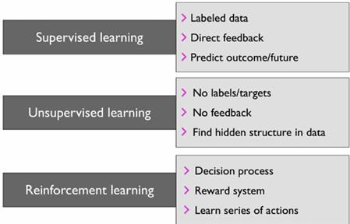
Types of machine learning
AI/ML Professional Training Program: INNOQUEST COHORT-1
Instructor: Prof. Ahmad Raza Shahid

Slide 7
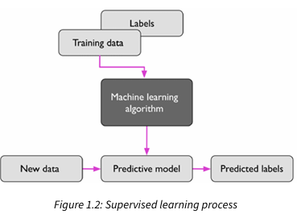
Supervised learning
AI/ML Professional Training Program: INNOQUEST COHORT-1
Instructor: Prof. Ahmad Raza Shahid
Notes:
supervised learning is to learn a model from labeled training data that allows us to make predictions about unseen or future data.
the term “supervised” refers to a set of training examples (data inputs) where the desired output signals (labels) are already known.
Supervised learn ing is then the process of modeling the relationship between the data inputs and the labels. Thus, we can also think of supervised learning as “label learning.”

Slide 8
Types of supervised learning
Classification (discrete labels)
Regression (continuous values)
AI/ML Professional Training Program: INNOQUEST COHORT-1
Instructor: Prof. Ahmad Raza Shahid
Notes:
A supervised learning task with discrete class labels, such as in the previous email spam filtering example, is also called a classification task.
Another subcategory of supervised learning is regression, where the outcome signal is a continuous value.

Slide 9
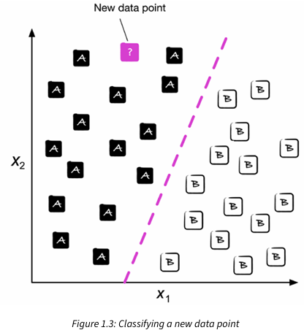
Classification
Figure. illustrates the concept of a binary classification task given 30 training examples; 15 training examples are labeled as class A and 15 training examples are labeled as class B. In this scenario, our dataset is two-dimensional, which means that each example has two values associated with it: x1 and x2. Now, we can use a supervised machine learning algorithm to learn a rule—the decision boundary represented as a dashed line—that can separate those two classes and classify new data into each of those two categories given its x1 and x2 values
AI/ML Professional Training Program: INNOQUEST COHORT-1
Instructor: Prof. Ahmad Raza Shahid
Notes:
predict the categorical class labels of new instances or data points based on past observations.
a binary classification task, where the machine learning algorithm learns a set of rules to distinguish between two possible classes: spam and non-spam emails.
multiclass classification task is handwritten character recognition. We can collect a training dataset that consists of multiple handwritten examples of each letter in the alphabet.

Slide 10
Regression
Analyze the relationship between dependent (target) and independent (input) variables.
It predicts continuous, numerical values as outputs based on the input features.
AI/ML Professional Training Program: INNOQUEST COHORT-1
Instructor: Prof. Ahmad Raza Shahid
Notes:
A second type of supervised learning is the prediction of continuous outcomes, which is also called regression analysis.
In regression analysis, we are given a number of predictor (explanatory) variables and a continuous response variable (outcome), and we try to find a relationship between those variables that allows us to predict an outcome.

Slide 11
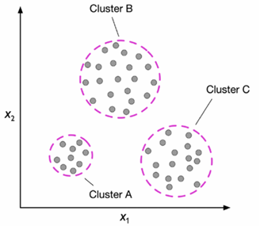
Unsupervised Learning
Clustering
Figure. illustrates how clustering can be applied to organizing unlabeled data into three distinct groups or clusters (A, B, and C, in arbitrary order) based on the similarity of their features, x1 and x2
AI/ML Professional Training Program: INNOQUEST COHORT-1
Instructor: Prof. Ahmad Raza Shahid
Notes:
In unsupervised learning, however, we are dealing with unlabeled data or data of an unknown structure.
Using unsupervised learning techniques, we are able to explore the structure of our data to extract meaningful information without the guidance of a known outcome variable or reward function.
Clustering is an exploratory data analysis or pattern discovery technique that allows us to organize a pile of information into meaningful subgroups (clusters) without having any prior knowledge of their group memberships
Each cluster that arises during the analysis defines a group of objects that share a certain degree of similarity but are more dissimilar to objects in other clusters, which is why clustering is also sometimes called unsupervised classification.
Clustering is a great technique for structuring information and deriving meaningful relationships from data.

Slide 12
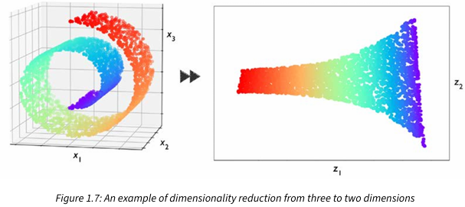
Unsupervised learning
Dimensionality Reduction
Figure 1.7 shows an example where nonlinear dimensionality reduction was applied to compress a 3D Swiss roll onto a new 2D feature subspace
AI/ML Professional Training Program: INNOQUEST COHORT-1
Instructor: Prof. Ahmad Raza Shahid
Notes:
Another subfield of unsupervised learning is dimensionality reduction

Slide 13
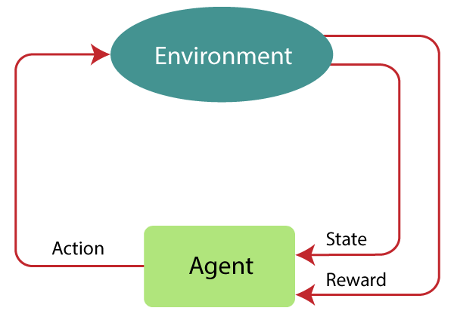
Reinforcement learning
AI/ML Professional Training Program: INNOQUEST COHORT-1
Instructor: Prof. Ahmad Raza Shahid
Notes:
In reinforcement learning, the goal is to develop a system (agent) that improves its performance based on interactions with the environment.

Slide 14
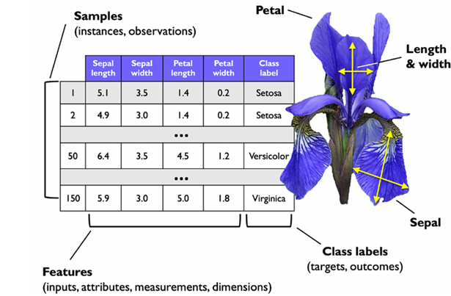
Basic terminologies
Notes:
Samples
Features
Class labels
Training Data
Test Data

Slide 15
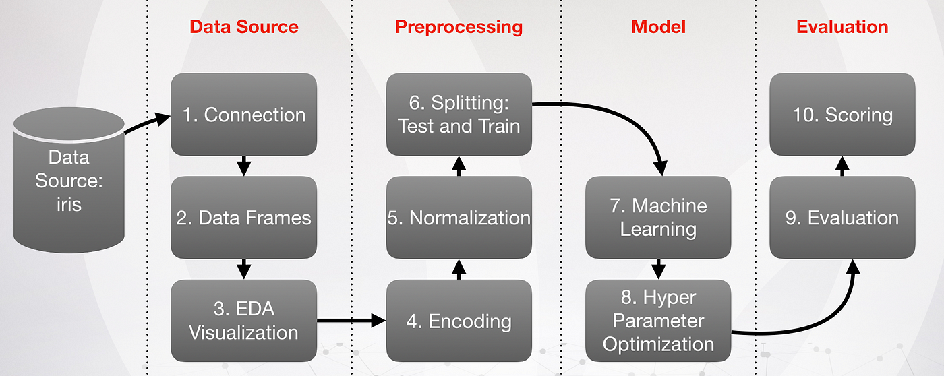
General end-to-end pipeline for machine learning systems
AI/ML Professional Training Program: INNOQUEST COHORT-1
Instructor: Prof. Ahmad Raza Shahid

Slide 16
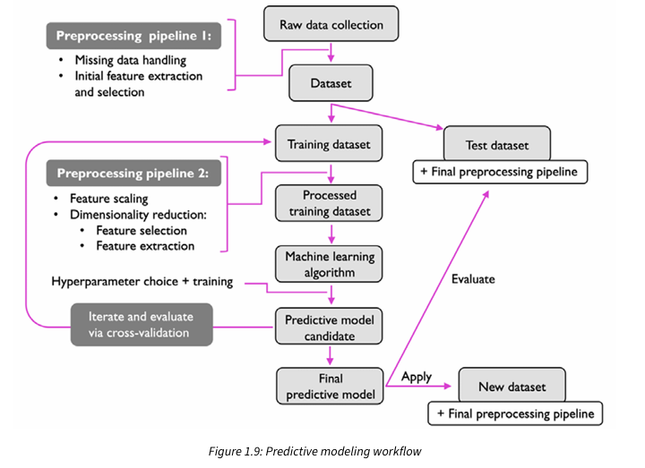
Detailed roadmap for building machine learning systems

Slide 17
Data preprocessing
Feature scaling
Feature scaling is a preprocessing technique used in machine learning to standardize the range of independent features (input data)
Min-Max Scaling (Normalization)
rescaling of the features to a range of [0, 1]
Standardization (Z-Score Scaling)
Robustscaler
recommended if working with small datasets that contain many outliers
AI/ML Professional Training Program: INNOQUEST COHORT-1
Instructor: Prof. Ahmad Raza Shahid
Notes:
Improves Convergence: Scaled features help optimization algorithms converge faster.
Ensures Fairness: Prevents features with larger ranges from dominating models.
Standardization shifts the mean of each feature so that it is centered at zero and each feature has a standard deviation of 1 (unit variance).
standardization can be more practical for many machine learning algorithms, especially for optimization algorithms such as gradient descent. The reason is that many linear models, such as the logistic regression and SVM from, initialize the weights to 0 or small random values close to 0. Using standardization, we center the feature columns at mean 0 with standard deviation 1 so that the feature columns have the same parameters as a standard normal distribution (zero mean and unit variance), which makes it easier to learn the weights. However, we shall emphasize that standardization does not change the shape of the distribution, and it does not transform non-normally distributed data into normally distributed data.
standardization maintains useful information about outliers and makes the algorithm less sensitive to them in contrast to min-max scaling, which scales the data to a limited range of values.
Regularization is another reason why feature scaling such as standardization is import ant. For regularization to work properly, we need to ensure that all our features are on comparable scales.
RobustScaler is especially helpful and recommended if we are working with small datasets that contain many outliers. Similarly, if the machine learning algorithm applied to this dataset is prone to overfitting, RobustScaler can be a good choice. Operating on each feature column independently, RobustScaler removes the median value and scales the dataset according to the 1st and 3rd quartile of the dataset (that is, the 25th and 75th quantile, respectively) such that more extreme values and outliers become less pronounced.
Decision trees and random forests are two of the very few machine learning algorithms where we don’t need to worry about feature scaling. Those algorithms are scale-invariant.

Slide 18
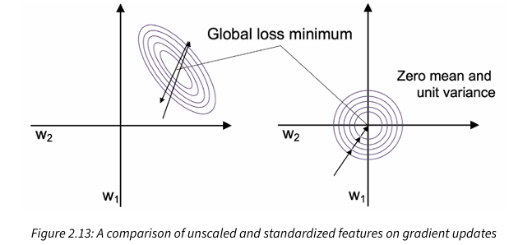
Standardization
Figure 2.13 illustrates possible gradient updates with unscaled features (left) and standardized features (right), where the concentric circles represent the loss surface as a function of two model weights in a two-dimensional classification problem
AI/ML Professional Training Program: INNOQUEST COHORT-1
Instructor: Prof. Ahmad Raza Shahid

Slide 19
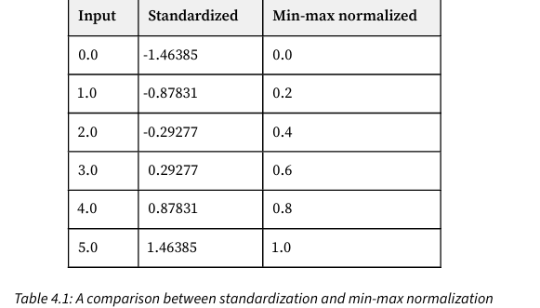
Standardization and Normalization
The table illustrates the difference between the two commonly used feature scaling techniques, standardization and normalization, on a simple example dataset consisting of numbers 0 to 5
AI/ML Professional Training Program: INNOQUEST COHORT-1
Instructor: Prof. Ahmad Raza Shahid

Slide 20
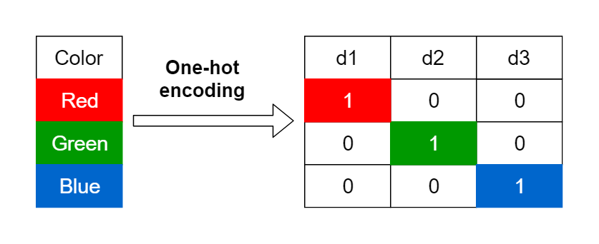
Data preprocessing
One hot encoding
Convert ordinal features into integers
one-hot encoding convert the indices into vectors of zeros and ones.
AI/ML Professional Training Program: INNOQUEST COHORT-1
Instructor: Prof. Ahmad Raza Shahid
Notes:
Apply one-hot encoding on nominal features
Convert the categorical data into binary format

Slide 21
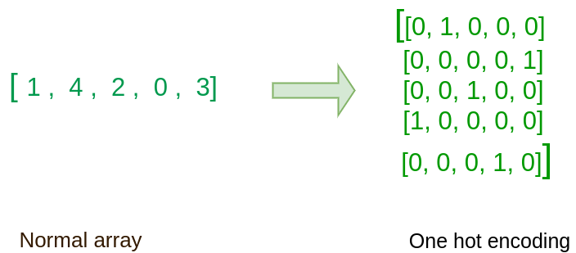
One hot encoding
AI/ML Professional Training Program: INNOQUEST COHORT-1
Instructor: Prof. Ahmad Raza Shahid

Slide 22
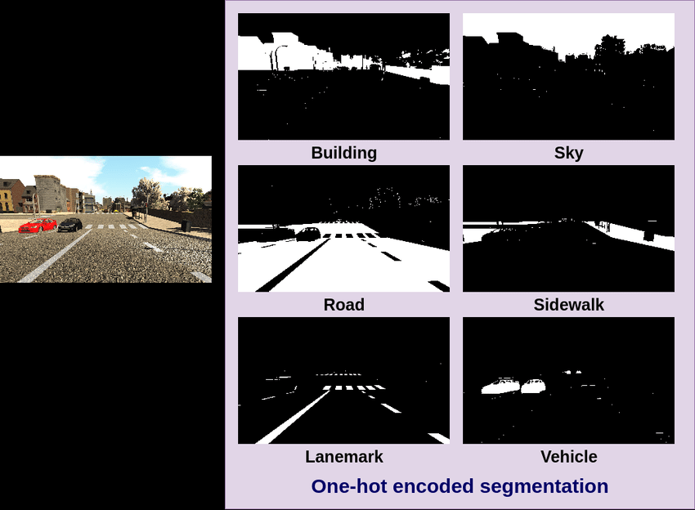
One hot encoding
AI/ML Professional Training Program: INNOQUEST COHORT-1
Instructor: Prof. Ahmad Raza Shahid

Slide 23
Data preprocessing
Vectorization
All inputs and targets in a neural network must be tensors of floating-point data (or, in specific cases, tensors of integers).
Whatever data you need to process—sound, images, text—you must first turn into tensors, a step called data vectorization
AI/ML Professional Training Program: INNOQUEST COHORT-1
Instructor: Prof. Ahmad Raza Shahid

Slide 24
What is vectorization?
Replacing iterative operations (e.g., loops) with vectorized implementations using libraries.
Improves computational efficiency and speeds up model training and inference.
Z = wx + b
non-vectorized vectorized
Z = 0 z = np.dot(w,x) + b
For I in range(1-x):
z += w[i] * x[i]
Z +=b
AI/ML Professional Training Program: INNOQUEST COHORT-1
Instructor: Prof. Ahmad Raza Shahid

Slide 25
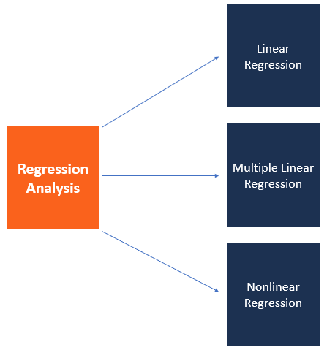
Predicting continuous target variables with regression analysis
AI/ML Professional Training Program: INNOQUEST COHORT-1
Instructor: Prof. Ahmad Raza Shahid

Slide 26
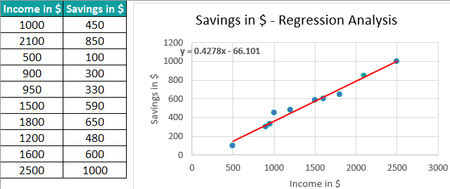
Regression examples
Income and Saving
AI/ML Professional Training Program: INNOQUEST COHORT-1
Instructor: Prof. Ahmad Raza Shahid

Slide 27
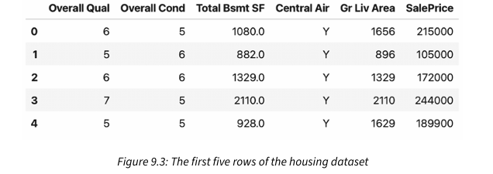
House sale price
AI/ML Professional Training Program: INNOQUEST COHORT-1
Instructor: Prof. Ahmad Raza Shahid

Slide 28
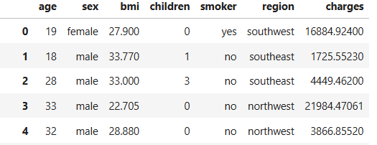
Health insurance
AI/ML Professional Training Program: INNOQUEST COHORT-1
Instructor: Prof. Ahmad Raza Shahid

Slide 29
Linear Regression
goal of linear regression is to model the relationship between one or multiple features and a continuous target variable.
Simple linear regression (univariate): find the relationship between a single feature and continuous-valued target
y = wx + b
AI/ML Professional Training Program: INNOQUEST COHORT-1
Instructor: Prof. Ahmad Raza Shahid

Slide 30
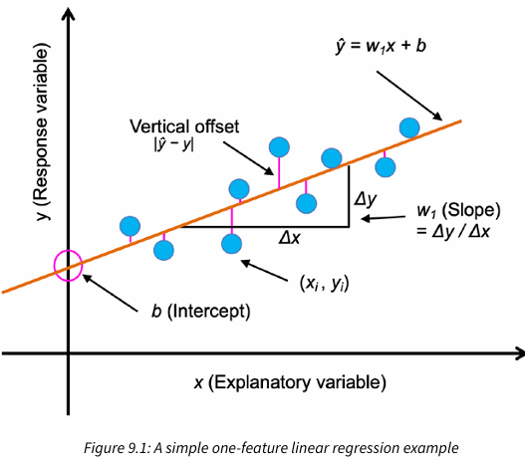
AI/ML Professional Training Program: INNOQUEST COHORT-1
Instructor: Prof. Ahmad Raza Shahid
Notes:
This best-fitting line is also called the regression line, and the vertical lines from the regression line to the training examples are the so-called offsets or residuals—the errors of our prediction.

Slide 31
Example
Regression
Prediction of the price of a used car
Inputs:
Brand
Year
Engine capacity
Mileage
Output
Price of the car
Where the output is a number is a regression problem.
AI/ML Professional Training Program: INNOQUEST COHORT-1
Instructor: Prof. Ahmad Raza Shahid

Slide 32
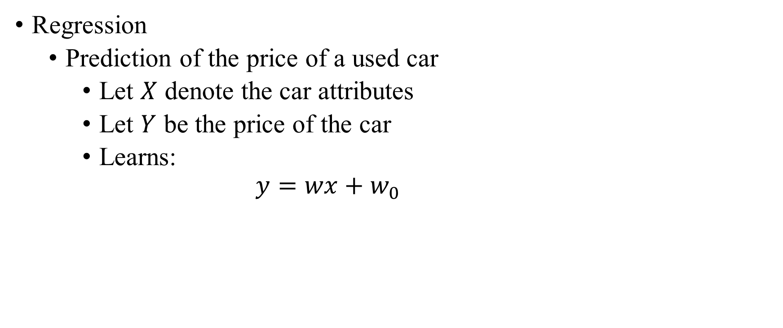
Example
Regression
Prediction of the price of a used car
Let $X$ denote the car attributes
Let $Y$ be the price of the car
Learns:
$$y=wx+w_{0}$$
AI/ML Professional Training Program: INNOQUEST COHORT-1
Instructor: Prof. Ahmad Raza Shahid

Slide 33
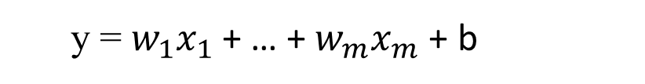
Multiple linear regression
find the relationship between a multiple features and continuous-valued target
y = $w_{1}x_{1}$ + … + $w_{m}x_{m}$ + b
AI/ML Professional Training Program: INNOQUEST COHORT-1
Instructor: Prof. Ahmad Raza Shahid
Notes:
we can also generalize the linear regression model to multiple explanatory variables; this process is called multiple linear regression

Slide 34
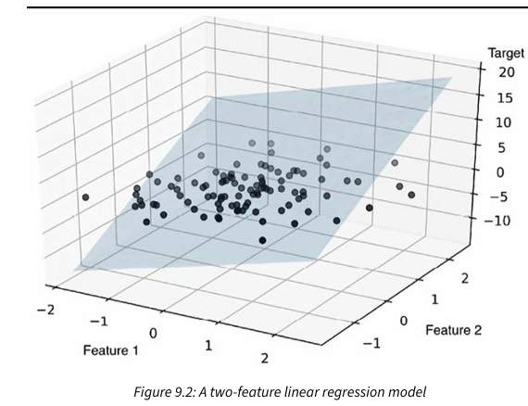
figure 9.2 shows how the two-dimensional, fitted hyperplane of a multiple linear regression model with two features could look
AI/ML Professional Training Program: INNOQUEST COHORT-1
Instructor: Prof. Ahmad Raza Shahid

Slide 35
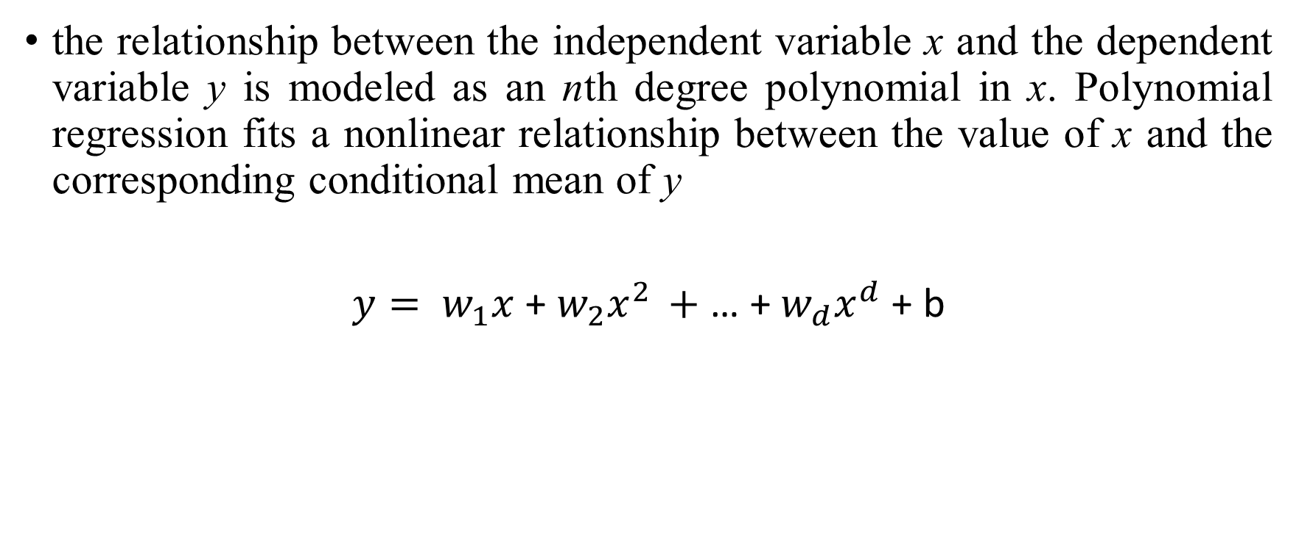
Polynomial regression
the relationship between the independent variable x and the dependent variable y is modeled as an nth degree polynomial in x. Polynomial regression fits a nonlinear relationship between the value of x and the corresponding conditional mean of y
${y= w}_{1}x$ + $w_{2}x^{2 }+$ … + $w_{d}x^{d}$+ b
AI/ML Professional Training Program: INNOQUEST COHORT-1
Instructor: Prof. Ahmad Raza Shahid

Slide 36

AI/ML Professional Training Program: INNOQUEST COHORT-1
Instructor: Prof. Ahmad Raza Shahid

Slide 37
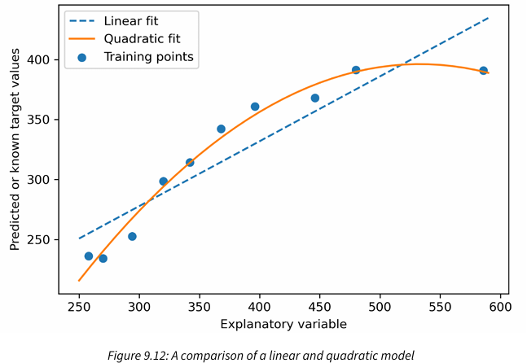
In the resulting plot, you can see that the polynomial fit captures the relationship between the response and explanatory variables much better than the linear fit
AI/ML Professional Training Program: INNOQUEST COHORT-1
Instructor: Prof. Ahmad Raza Shahid

Slide 38
Overfitting and underfitting
The fundamental issue in machine learning is the tension between optimization and generalization.
Optimization refers to the process of adjusting a model to get the best performance possible on the training data (the learning in machine learning), whereas generalization refers to how well the trained model performs on data it has never seen before.
The goal of the game is to get good generalization, of course, but you don’t control generalization; you can only adjust the model based on its training data
AI/ML Professional Training Program: INNOQUEST COHORT-1
Instructor: Prof. Ahmad Raza Shahid
Notes:
A model that perfectly match the training data has a problem.
It will also overfit to the data, modeling noise
A random word that perfectly predicts y (it happens to only occur in one class) will get a very high weight.
Failing to generalize to a test set without this word.
A good model should be able to generalize
Models that are too powerful can overfit the data
Fitting the details of the training data so exactly that the model doesn't generalize well to the test set

Slide 39
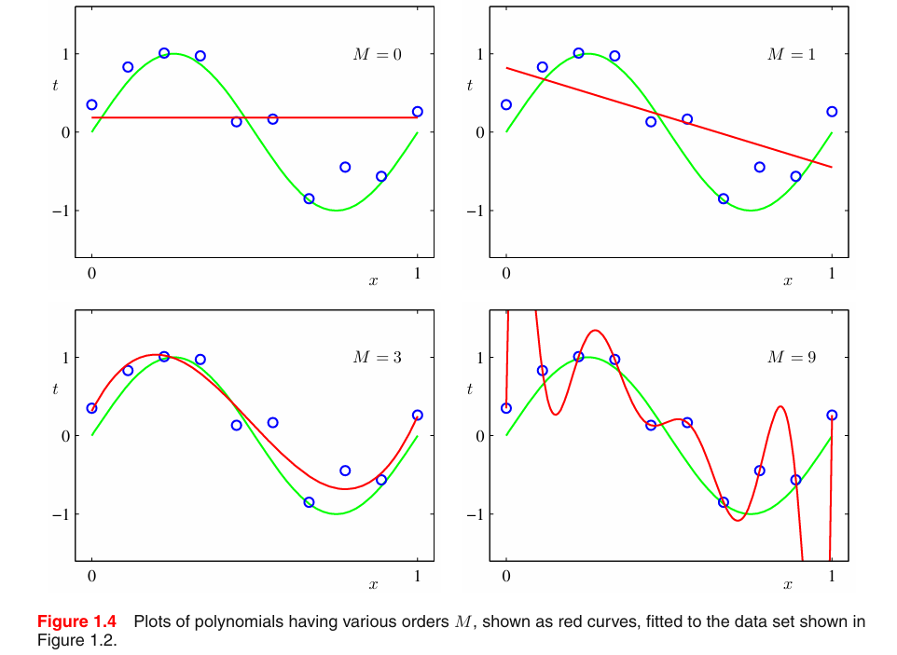
Over-fitting
AI/ML Professional Training Program: INNOQUEST COHORT-1
Instructor: Prof. Ahmad Raza Shahid

Slide 40
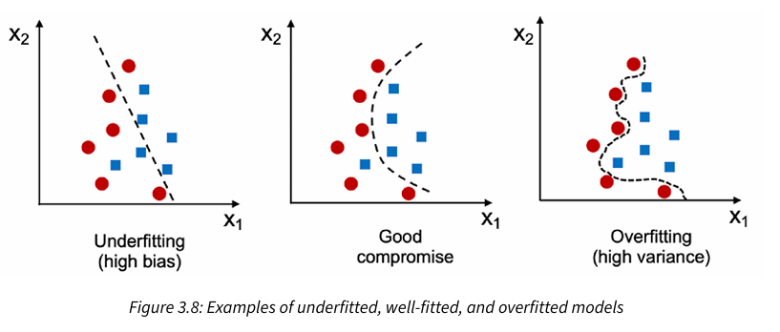
AI/ML Professional Training Program: INNOQUEST COHORT-1
Instructor: Prof. Ahmad Raza Shahid

Slide 41
Over-fitting
How to avoid overfitting?
Regularization in machine learning
Dropout in neural networks
AI/ML Professional Training Program: INNOQUEST COHORT-1
Instructor: Prof. Ahmad Raza Shahid

Slide 42
Regularization
A solution for overfitting
Add a regularization term R(θ) to the loss function (for now written as maximizing log prob rather than minimizing loss)
Idea: choose an R(θ) that penalizes large weights
fitting the data well with lots of big weights not as good as fitting the data a little less well, with small weights
AI/ML Professional Training Program: INNOQUEST COHORT-1
Instructor: Prof. Ahmad Raza Shahid
Notes:
To prevent a model from learning misleading or irrelevant patterns found in the training data, the best solution is to get more training data
If a network can only afford to memorize a small number of patterns, the optimization process will force it to focus on the most prominent patterns, which have a better chance of generalizing well
The processing of fighting overfitting this way is called regularization

Slide 43
Regularization methods for regression
The most popular approaches to regularized linear regression are:
ridge regression (L2)
least absolute shrinkage and selection operator (LASSO) (L1)
AI/ML Professional Training Program: INNOQUEST COHORT-1
Instructor: Prof. Ahmad Raza Shahid

Slide 44
Evaluation metrics for regression
Mean squared error (MSE)
Root mean squared error (RMSE)
Mean absolute error (MAE)
Mean absolute percentage error (MAPE)
R Square
AI/ML Professional Training Program: INNOQUEST COHORT-1
Instructor: Prof. Ahmad Raza Shahid

Slide 45
Predicting discrete target variables with classification analysis
AI/ML Professional Training Program: INNOQUEST COHORT-1
Instructor: Prof. Ahmad Raza Shahid

Slide 46
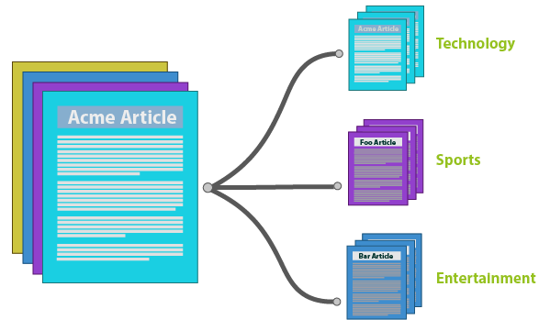
Articles classification
AI/ML Professional Training Program: INNOQUEST COHORT-1
Instructor: Prof. Ahmad Raza Shahid

Slide 47

Spam classification
AI/ML Professional Training Program: INNOQUEST COHORT-1
Instructor: Prof. Ahmad Raza Shahid

Slide 48
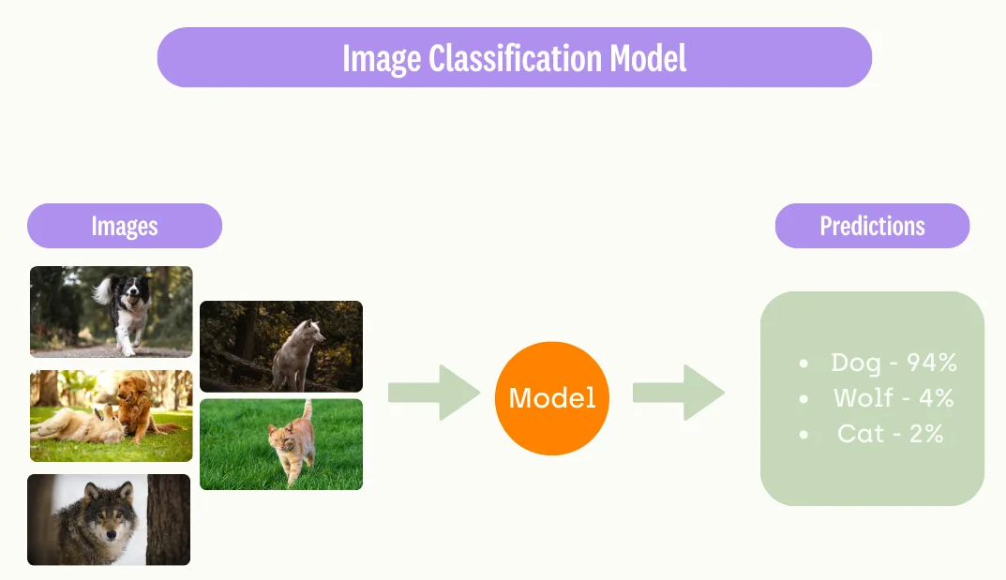
Image classification
AI/ML Professional Training Program: INNOQUEST COHORT-1
Instructor: Prof. Ahmad Raza Shahid

Slide 49
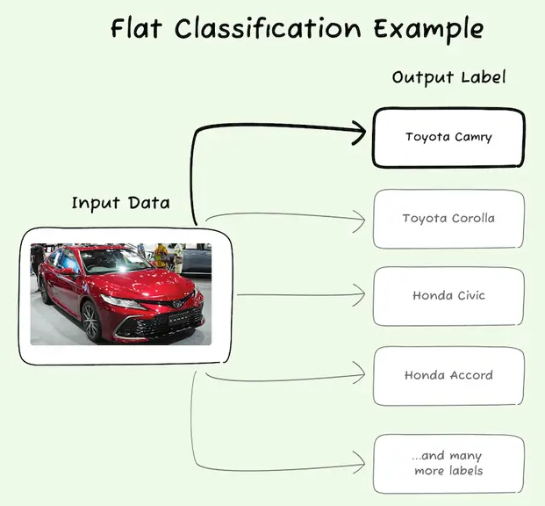
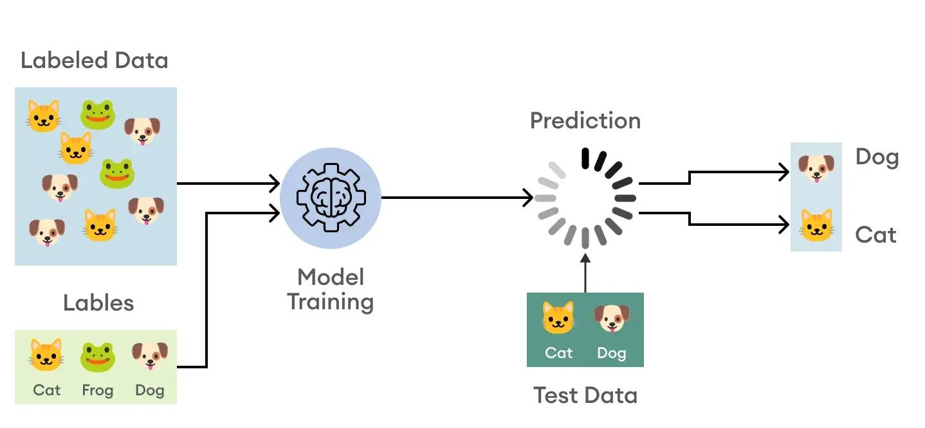
Image classification
AI/ML Professional Training Program: INNOQUEST COHORT-1
Instructor: Prof. Ahmad Raza Shahid

Slide 50
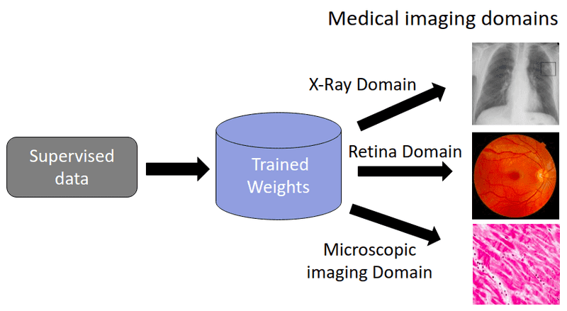
Medical image classification
AI/ML Professional Training Program: INNOQUEST COHORT-1
Instructor: Prof. Ahmad Raza Shahid

Slide 51
Iris dataset
AI/ML Professional Training Program: INNOQUEST COHORT-1
Instructor: Prof. Ahmad Raza Shahid

Slide 52
Logistic regression for classification

Slide 53
The two phases of logistic regression
Training: we learn weights w and b using stochastic gradient descent and cross-entropy loss.
Test: Given a test example x we compute p(y|x) using learned weights w and b, and return whichever label (y = 1 or y = 0) is higher probability
AI/ML Professional Training Program: INNOQUEST COHORT-1
Instructor: Prof. Ahmad Raza Shahid

Slide 54
The problem: z isn't a probability, it's just a number!
Solution: use a function of z that goes from 0 to 1
AI/ML Professional Training Program: INNOQUEST COHORT-1
Instructor: Prof. Ahmad Raza Shahid
Notes:
nothing in Eq. 5.3 forces z to be a legal probability, that is, to lie between 0 and 1. In fact, since weights are real-valued, the output might even be negative; z ranges from −∞ to ∞.

Slide 55
The very useful sigmoid or logistic function
AI/ML Professional Training Program: INNOQUEST COHORT-1
Instructor: Prof. Ahmad Raza Shahid
Notes:
The sigmoid function The 1/1+e^-z (so-named because it looks like an s) is also called the logistic function. It takes a real value and maps it to the range [0, 1
It is nearly linear around 0 but outlier values get squashed toward 0 or 1.

Slide 56
Idea of logistic regression
We’ll compute w∙x+b
And then we’ll pass it through the sigmoid function:
σ(w∙x+b)
And we'll just treat it as a probability
AI/ML Professional Training Program: INNOQUEST COHORT-1
Instructor: Prof. Ahmad Raza Shahid

Slide 57
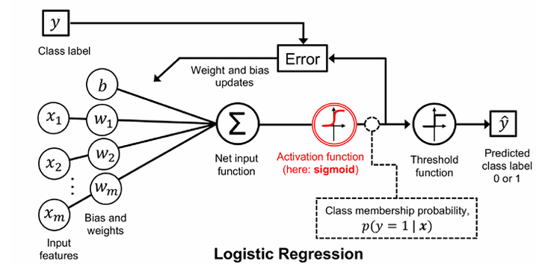
Logistic regression model
AI/ML Professional Training Program: INNOQUEST COHORT-1
Instructor: Prof. Ahmad Raza Shahid

Slide 58
Making probabilities with sigmoid
AI/ML Professional Training Program: INNOQUEST COHORT-1
Instructor: Prof. Ahmad Raza Shahid
Notes:
We’re almost there. If we apply the sigmoid to the sum of the weighted features, we get a number between 0 and 1. To make it a probability, we just need to make sure that the two cases, p(y = 1) and p(y = 0), sum to 1. We can do this as follows:

Slide 59
By the way:
=
Because
AI/ML Professional Training Program: INNOQUEST COHORT-1
Instructor: Prof. Ahmad Raza Shahid
Notes:
The sigmoid function has the property

Slide 60
Turning a probability into a classifier
0.5 here is called the decision boundary
AI/ML Professional Training Program: INNOQUEST COHORT-1
Instructor: Prof. Ahmad Raza Shahid

Slide 61
The probabilistic classifier
P(y=1)
wx + b

Slide 62
Turning a probability into a classifier
if w∙x+b > 0
if w∙x+b ≤ 0
AI/ML Professional Training Program: INNOQUEST COHORT-1
Instructor: Prof. Ahmad Raza Shahid

Slide 63
Logistic regression: a text example on sentiment classification
Notes:
Let's walk through an example using logistic regression to do sentiment classification

Slide 64
Sentiment example: does y=1 or y=0?
It's hokey . There are virtually no surprises , and the writing is second-rate . So why was it so enjoyable ? For one thing , the cast is great . Another nice touch is the music . I was overcome with the urge to get off the couch and start dancing . It sucked me in , and it'll do the same to you .
AI/ML Professional Training Program: INNOQUEST COHORT-1
Instructor: Prof. Ahmad Raza Shahid
Notes:
Suppose we are doing binary sentiment classification on movie review text, and we would like to know whether to assign the sentiment class 1=positive or 0=negative to the following review

Slide 65
AI/ML Professional Training Program: INNOQUEST COHORT-1
Instructor: Prof. Ahmad Raza Shahid
Notes:
We’ll represent each input observation by the 6 features x1...x6 of the input

Slide 66
Classifying sentiment for input x
Suppose w =
b = 0.1
Notes:
Let’s assume for the moment that we’ve already learned a real-valued weight for each of these features, and that the 6 weights corresponding to the 6 features are as follows. The weight w1, for example indicates how important a feature the number of positive lexicon words (great, nice, enjoyable, etc.) is to a positive sentiment decision, while w2 tells us the importance of negative lexicon words. Note that w1 = 2.5 is positive, while w2 = −5.0, meaning that negative words are negatively associated with a positive sentiment decision, and are about twice as important as positive words.

Slide 67
Classifying sentiment for input x
AI/ML Professional Training Program: INNOQUEST COHORT-1
Instructor: Prof. Ahmad Raza Shahid
Notes:
Given these 6 features and the input review x, we can compute P(+|x) and P(−|x)

Slide 68
Cross-Entropy loss
Notes:
Let's now turn to learning the parameters for logistic regression. We'll start with the cross-entropy loss function

Slide 69
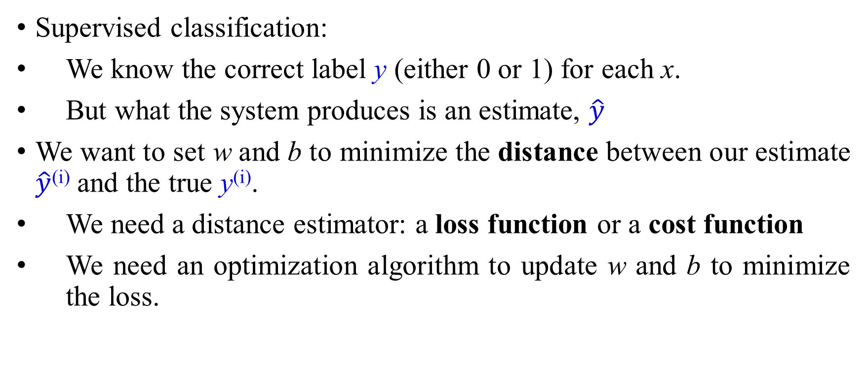
Where did the W’s come from?
Supervised classification:
We know the correct label y (either 0 or 1) for each x.
But what the system produces is an estimate, $\hat{y}$
We want to set w and b to minimize the distance between our estimate $\hat{y}$^{(i)} and the true y^{(i)}.
We need a distance estimator: a loss function or a cost function
We need an optimization algorithm to update w and b to minimize the loss.
AI/ML Professional Training Program: INNOQUEST COHORT-1
Instructor: Prof. Ahmad Raza Shahid
Notes:
Logistic regression is an instance of supervised classification in which we know the correct label y (either 0 or 1) for each observation x. But what the system produces is an estimate, ^y. We want to learn parameters (meaning w and b) that make yˆ for each training observation as close as possible to the true y.

Slide 70
Learning components
A loss function:
cross-entropy loss
An optimization algorithm:
stochastic gradient descent
AI/ML Professional Training Program: INNOQUEST COHORT-1
Instructor: Prof. Ahmad Raza Shahid
Notes:
This requires two components. The first is a metric for how close the current label (yˆ) is to the true gold label y. Rather than measure similarity, we usually talk about the opposite of this: the distance between the system output and the gold output, and we call this distance
the loss function or the cost function. We'll we’ll introduce the loss function that is commonly used for logistic regression and also for neural networks, the cross-entropy loss. The second thing we need is an optimization algorithm for iteratively updating
the weights so as to minimize this loss function. The standard algorithm for this is gradient descent; we’ll introduce the stochastic gradient descent algorithm in the following section.

Slide 71

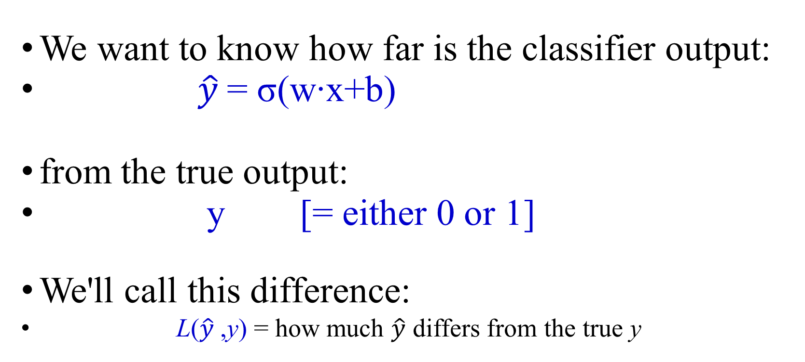
The distance between $\hat{y}$and y
We want to know how far is the classifier output:
$\hat{y}$= σ(w∙x+b)
from the true output:
y [= either 0 or 1]
We'll call this difference:
L($\hat{y}$,y) = how much $\hat{y}$ differs from the true y
AI/ML Professional Training Program: INNOQUEST COHORT-1
Instructor: Prof. Ahmad Raza Shahid
Notes:
We need a loss function that expresses, for an observation x, how close the classifier output (yˆ = σ (w · x + b)) is to the correct output (y, which is 0 or 1).

Slide 72
Intuition of negative log likelihood loss = cross-entropy loss
A case of conditional maximum likelihood estimation
We choose the parameters w,b that maximize the log probability of the true y labels in the training data given the observations x
AI/ML Professional Training Program: INNOQUEST COHORT-1
Instructor: Prof. Ahmad Raza Shahid
Notes:
We do this via a loss function that prefers the correct class labels of the training examples to be more likely. This is called conditional maximum likelihood estimation: we choose the parameters w,b that maximize the log probability of the true y labels in the training data given the observations x. The resulting loss function is the negative log likelihood loss, generally called the cross-entropy loss.

Slide 73
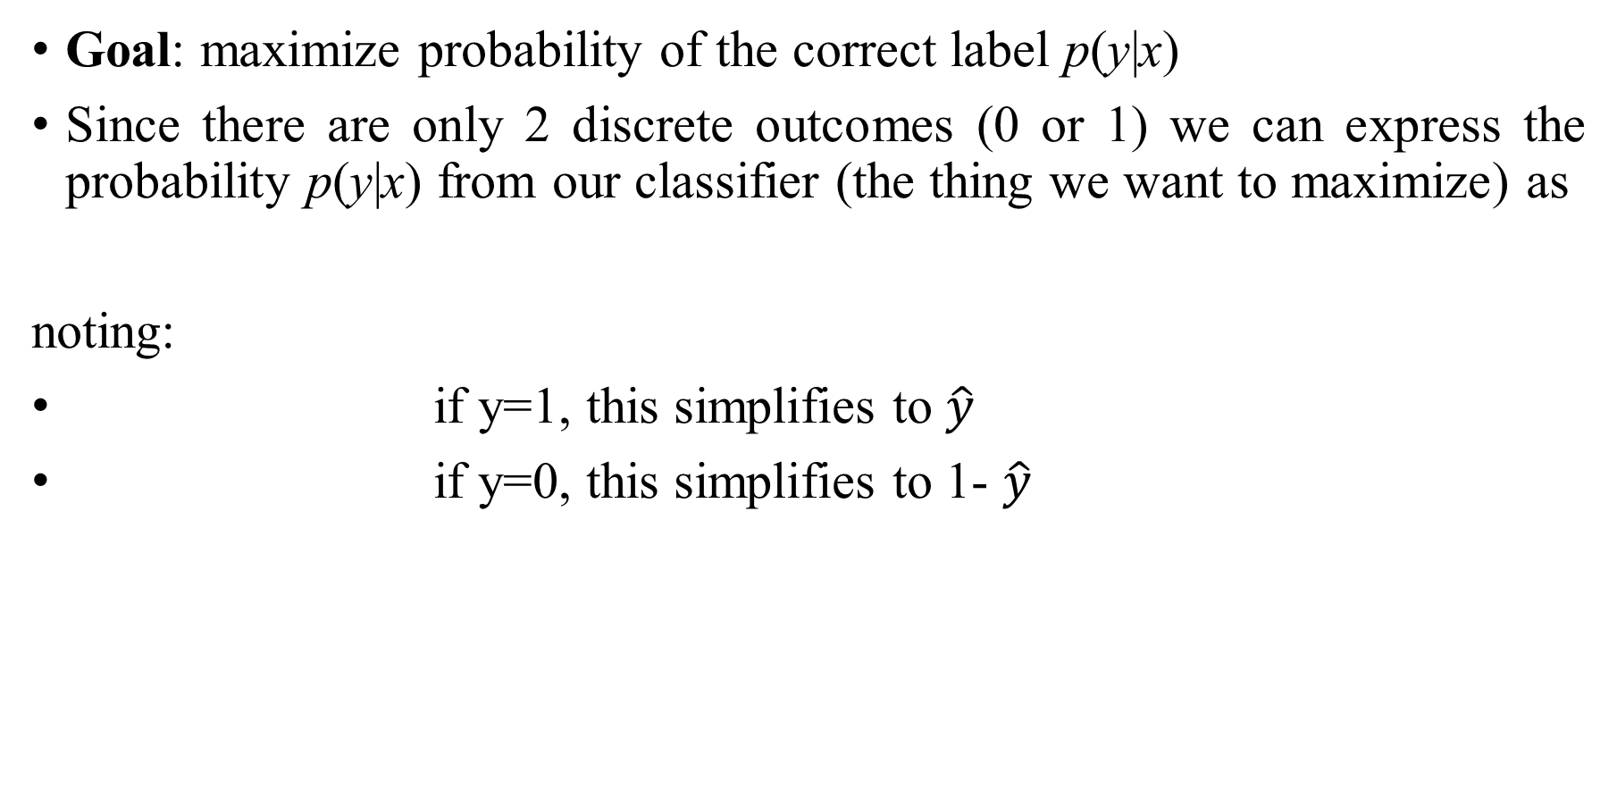
Deriving cross-entropy loss for a single observation x
Goal: maximize probability of the correct label p(y|x)
Since there are only 2 discrete outcomes (0 or 1) we can express the probability p(y|x) from our classifier (the thing we want to maximize) as
noting:
if y=1, this simplifies to $\hat{y}$
if y=0, this simplifies to 1- $\hat{y}$
AI/ML Professional Training Program: INNOQUEST COHORT-1
Instructor: Prof. Ahmad Raza Shahid
Notes:
Let’s derive this loss function, applied to a single observation x. We’d like to learn weights that maximize the probability of the correct label, that's p(y|x).

Slide 74
Deriving cross-entropy loss for a single observation x
Goal: maximize probability of the correct label p(y|x)
Maximize:
Now take the log of both sides (mathematically handy)
Whatever values maximize log p(y|x) will also maximize p(y|x)
Maximize:
AI/ML Professional Training Program: INNOQUEST COHORT-1
Instructor: Prof. Ahmad Raza Shahid

Slide 75
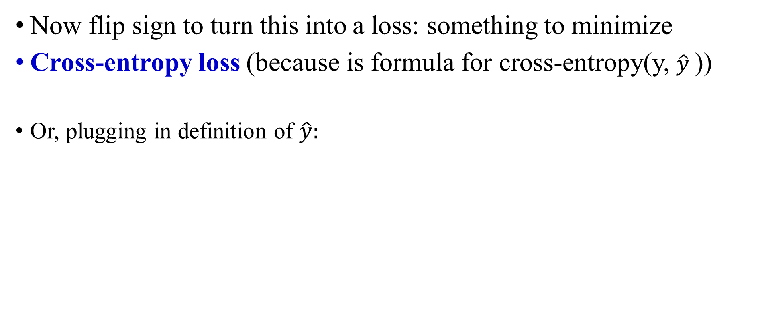
Deriving cross-entropy loss for a single observation x
Goal: maximize probability of the correct label p(y|x)
Maximize:
Now flip sign to turn this into a loss: something to minimize
Cross-entropy loss (because is formula for cross-entropy(y, $\hat{y}$))
Or, plugging in definition of $\hat{y}:$
Minimize:
AI/ML Professional Training Program: INNOQUEST COHORT-1
Instructor: Prof. Ahmad Raza Shahid

Slide 76
Let's see if this works for our sentiment example
We want loss to be:
smaller if the model estimate is close to correct
bigger if model is confused
Let's first suppose the true label of this is y=1 (positive)
It's hokey . There are virtually no surprises , and the writing is second-rate . So why was it so enjoyable ? For one thing , the cast is great . Another nice touch is the music . I was overcome with the urge to get off the couch and start dancing . It sucked me in , and it'll do the same to you .
AI/ML Professional Training Program: INNOQUEST COHORT-1
Instructor: Prof. Ahmad Raza Shahid

Slide 77
Let's see if this works for our sentiment example
True value is y=1. How well is our model doing?
Pretty well! What's the loss?
AI/ML Professional Training Program: INNOQUEST COHORT-1
Instructor: Prof. Ahmad Raza Shahid

Slide 78
Let's see if this works for our sentiment example
Suppose true value instead was y=0.
What's the loss?
AI/ML Professional Training Program: INNOQUEST COHORT-1
Instructor: Prof. Ahmad Raza Shahid
Notes:
By contrast, let’s pretend instead that the example was actually negative, i.e., the true y = 0 (perhaps the reviewer went on to say “But bottom line, the movie is terrible! I beg you not to see it!”) . In this case our model is confused, the model is wrong, so we’d want the loss to be higher. Let's plug in y = 0 and 1−σ(w·x+b) = .31

Slide 79
Let's see if this works for our sentiment example
The loss when model was right (if true y=1)
Is lower than the loss when model was wrong (if true y=0):
Sure enough, loss was bigger when model was wrong!
AI/ML Professional Training Program: INNOQUEST COHORT-1
Instructor: Prof. Ahmad Raza Shahid

Slide 80
Stochastic gradient descent
Notes:
In this lecture we introduce the stochastic gradient descent algorithm used for optimizing the weights for logistic regression and neural networks.

Slide 81
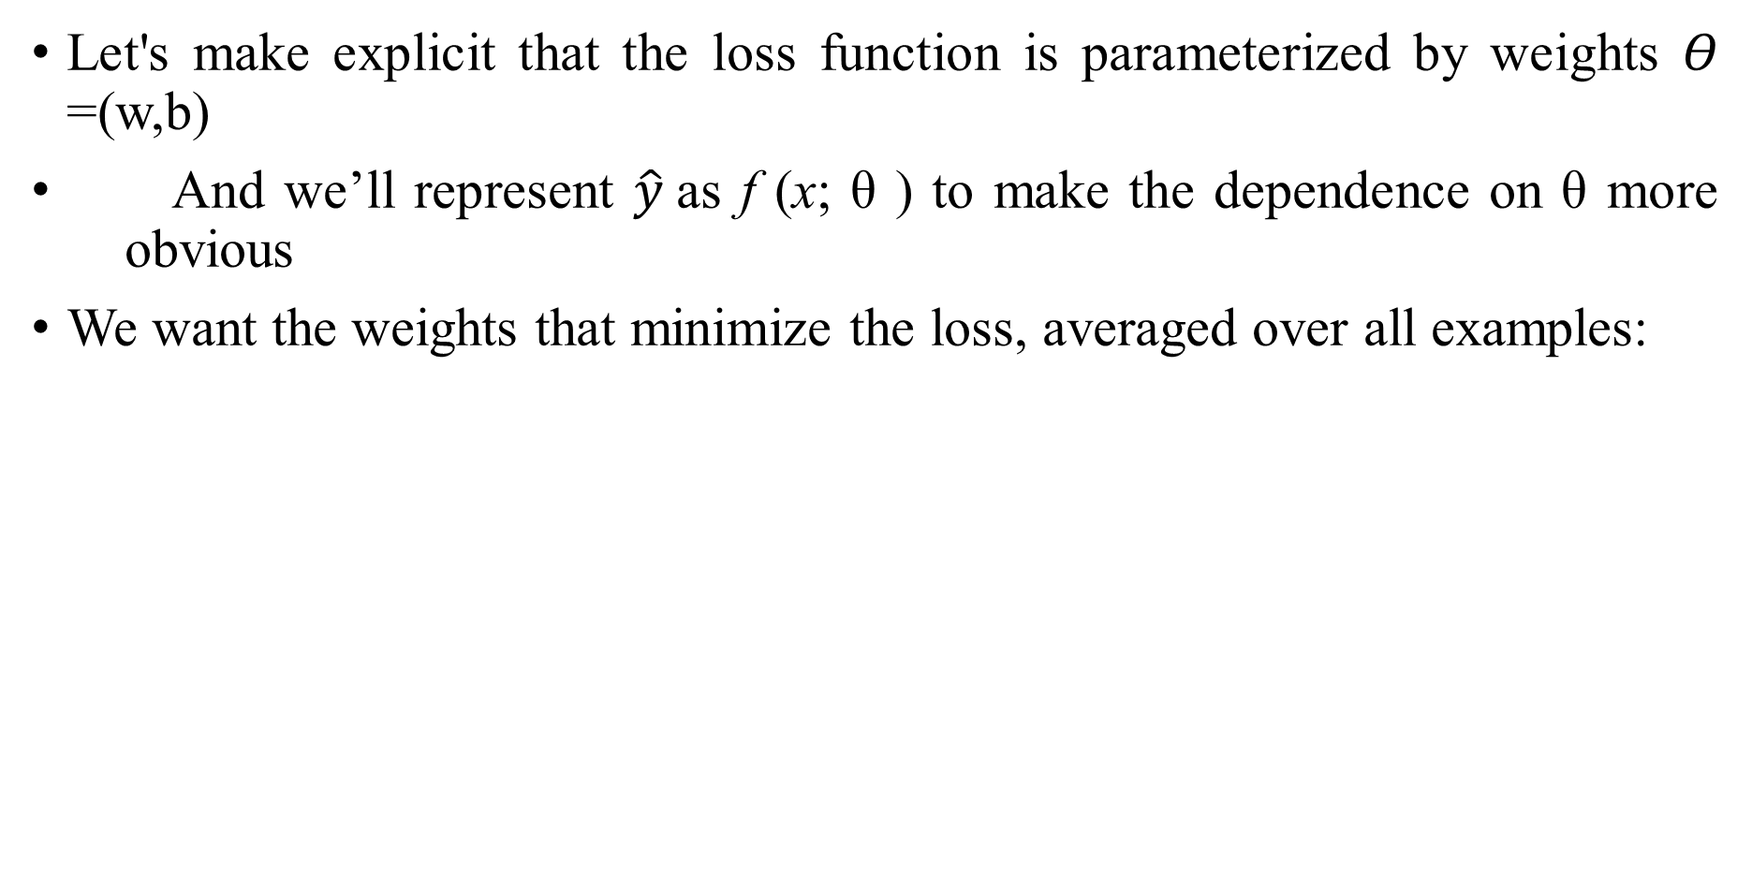
Our goal: minimize the loss
Let's make explicit that the loss function is parameterized by weights 𝛳=(w,b)
And we’ll represent $\hat{y}$as f (x; θ ) to make the dependence on θ more obvious
We want the weights that minimize the loss, averaged over all examples:
AI/ML Professional Training Program: INNOQUEST COHORT-1
Instructor: Prof. Ahmad Raza Shahid
Notes:
Our goal with gradient descent is to find the optimal weights: minimize the loss function we’ve defined for the model. We’ll explicitly represent the fact that the loss function L is parameterized by the weights, which we can refer to in machine learning in general as θ (in the case of logistic regression θ = w, b). And we’ll represent $\hat{y}$as f (x; θ ) to make the dependence on θ more obvious. So the goal is to find the set of weights which minimizes the loss function, averaged over all examples: EQ

Slide 82

Intuition of gradient descent
How do I get to the bottom of this river canyon?
Look around me 360∘
Find the direction of steepest slope down
Go that way
x
AI/ML Professional Training Program: INNOQUEST COHORT-1
Instructor: Prof. Ahmad Raza Shahid
Notes:
How do we find the minimum of a loss function? Gradient descent is a method that finds a minimum of a function by figuring out in which direction (in the space of the parameters θ) the function’s slope is rising the most steeply, and moving in the opposite direction.
The intuition is that if you are hiking in a canyon and trying to descend most quickly down to the river at the bottom, you might look around yourself 360 degrees, find the direction where the ground is sloping the steepest, and walk downhill in that direction.

Slide 83
Our goal: minimize the loss
For logistic regression, loss function is convex
A convex function has just one minimum
Gradient descent starting from any point is guaranteed to find the minimum
(Loss for neural networks is non-convex)
AI/ML Professional Training Program: INNOQUEST COHORT-1
Instructor: Prof. Ahmad Raza Shahid
Notes:
For logistic regression, this loss function is conveniently convex. A convex function has just one minimum; there are no local minima to get stuck in, so gradient descent starting from any point is guaranteed to find the minimum. (By contrast, the loss for multi-layer neural networks is non-convex, and gradient descent may get stuck in local minima for neural network training and never find the global optimum.)

Slide 84
Let's first visualize for a single scalar w
Q: Given current w, should we make it bigger or smaller?
A: Move w in the reverse direction from the slope of the function
AI/ML Professional Training Program: INNOQUEST COHORT-1
Instructor: Prof. Ahmad Raza Shahid
Notes:
Although the algorithm (and the concept of gradient) are designed for direction vectors, let’s first consider a visualization of the case where the parameter of our system is just a single scalar w. Given a random initialization of w at some value w1, and assuming the loss function L happened to have this shape, we need the algorithm to tell us whether at the next iteration we should move left (making w2 smaller than w1) or right (making w2 bigger than w1) to reach the minimum. The gradient descent algorithm answers this question by finding the gradient of the loss function at the current point and moving in the opposite direction.

Slide 85
Let's first visualize for a single scalar w
Q: Given current w, should we make it bigger or smaller?
A: Move w in the reverse direction from the slope of the function
So we'll move positive
AI/ML Professional Training Program: INNOQUEST COHORT-1
Instructor: Prof. Ahmad Raza Shahid
Notes:
The gradient of a function of many variables is a vector pointing in the direction of the greatest increase in a function. The gradient is a multi-variable generalization of the slope, so for a function of one variable like the one in this figure, we can informally think of the gradient as the slope. The dotted line shows the slope of this hypothetical loss function at point w = w1 . You can see that the slope of this dotted line is negative.

Slide 86
Let's first visualize for a single scalar w
Q: Given current w, should we make it bigger or smaller?
A: Move w in the reverse direction from the slope of the function
So we'll move positive
AI/ML Professional Training Program: INNOQUEST COHORT-1
Instructor: Prof. Ahmad Raza Shahid
Notes:
Thus to find the minimum, gradient descent tells us to go in the opposite direction: moving w in a positive direction.

Slide 87
Gradients
The gradient of a function of many variables is a vector pointing in the direction of the greatest increase in a function.
Gradient Descent: Find the gradient of the loss function at the current point and move in the opposite direction.
AI/ML Professional Training Program: INNOQUEST COHORT-1
Instructor: Prof. Ahmad Raza Shahid

Slide 88
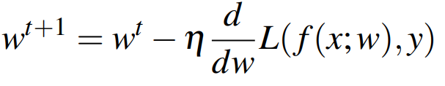
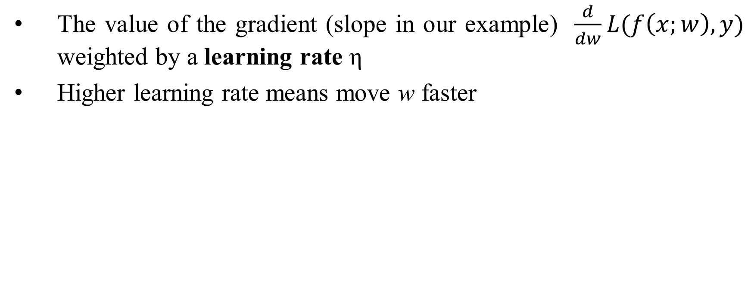
How much do we move in that direction ?
The value of the gradient (slope in our example) $\frac{d}{dw}L(f\left(x;w\right),y)$ weighted by a learning rate η
Higher learning rate means move w faster
AI/ML Professional Training Program: INNOQUEST COHORT-1
Instructor: Prof. Ahmad Raza Shahid
Notes:
The magnitude of the amount to move in gradient descent is the value of the slope of the loss function (with respect to w) weighted by a learning rate η . A higher (faster) learning rate means that we should move w more on each step. The change we make in our parameter is the learning rate times the gradient (or the slope, in our single-variable example)

Slide 89
Now let's consider N dimensions
We want to know where in the N-dimensional space (of the N parameters that make up θ ) we should move.
The gradient is just such a vector; it expresses the directional components of the sharpest slope along each of the N dimensions.
AI/ML Professional Training Program: INNOQUEST COHORT-1
Instructor: Prof. Ahmad Raza Shahid
Notes:
Now let’s extend the intuition from a function of one scalar variable w to many variables, because we don’t just want to move left or right, we want to know where in the N-dimensional space (of the N parameters that make up θ ) we should move. The gradient is just such a vector; it expresses the directional components of the sharpest slope along each of those N dimensions.

Slide 90
Imagine 2 dimensions, w and b
Visualizing the gradient vector at the red point
It has two dimensions shown in the x-y plane
AI/ML Professional Training Program: INNOQUEST COHORT-1
Instructor: Prof. Ahmad Raza Shahid
Notes:
If we’re just imagining two weight dimensions (say for one weight w and one bias b), the gradient might be a vector with two orthogonal components, each of which tells us how much the ground slopes in the w dimension and in the b dimension. This figure shows a visualization of the value of a 2-dimensional gradient vector taken at the red point.

Slide 91
Real gradients
Are much longer; lots and lots of weights
For each dimension w_{i} the gradient component i tells us the slope with respect to that variable.
“How much would a small change in w_{i} influence the total loss function L?”
We express the slope as a partial derivative ∂ of the loss ∂w_{i}
The gradient is then defined as a vector of these partials.
AI/ML Professional Training Program: INNOQUEST COHORT-1
Instructor: Prof. Ahmad Raza Shahid
Notes:
In an actual logistic regression, the parameter vector w is much longer than 1 or 2, since the input feature vector x can be quite long, and we need a weight wi for each xi. For each dimension/variable wi in w (plus the bias b), the gradient will have a component that tells us the slope with respect to that variable. Essentially we’re asking: “How much would a small change in that variable wi influence the total loss function L?” In each dimension wi, we express the slope as a partial derivative of the loss function with respect to wi. The gradient is then defined as a vector of these partials.

Slide 92
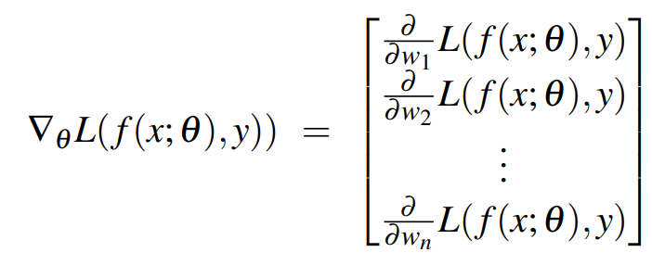
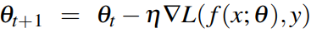
The gradient
We’ll represent $\hat{y}$as f (x; θ ) to make the dependence on θ more obvious:
The final equation for updating θ based on the gradient is thus
AI/ML Professional Training Program: INNOQUEST COHORT-1
Instructor: Prof. Ahmad Raza Shahid
Notes:
Here's a vector of gradients. We’ll represent yˆ as f (x; θ ) to make the dependence on θ more obvious:

Slide 93
What are these partial derivatives for logistic regression?
The loss function
The elegant derivative of this function (see textbook 5.8 for derivation)
AI/ML Professional Training Program: INNOQUEST COHORT-1
Instructor: Prof. Ahmad Raza Shahid
Notes:
In order to update θ , we need a definition for the gradient ∇L( f (x; θ ), y). Recall that for logistic regression, the cross-entropy loss function is: EQ
It turns out that the derivative of this function for one observation vector x is EQ
Note that the gradient with respect to a single weight w j represents a very intuitive value: the difference between the true y and our estimated yˆ = σ (w · x + b) for that observation, multiplied by the corresponding input value x j .

Slide 94
AI/ML Professional Training Program: INNOQUEST COHORT-1
Instructor: Prof. Ahmad Raza Shahid
Notes:
Stochastic gradient descent is an online algorithm that minimizes the loss function by computing its gradient after each training example, and nudging θ in the right direction (the opposite direction of the gradient). The algorithm can terminate when it converges (or when the gradient norm < ε), or when progress halts (for example when the loss starts going up on a held-out set).

Slide 95
Hyperparameters
The learning rate η is a hyperparameter
too high: the learner will take big steps and overshoot
too low: the learner will take too long
Hyperparameters:
Briefly, a special kind of parameter for an ML model
Instead of being learned by algorithm from supervision (like regular parameters), they are chosen by algorithm designer.
AI/ML Professional Training Program: INNOQUEST COHORT-1
Instructor: Prof. Ahmad Raza Shahid
Notes:
The learning rate η is a hyperparameter that must be adjusted. If it’s too high, the learner will take steps that are too large, overshooting the minimum of the loss function. If it’s too low, the learner will take steps that are too small, and take too long to get to the minimum. It is common to start with a higher learning rate and then slowly decrease it. Hyperparameters are a special kind of parameter for any machine learning model. Unlike regular parameters of a model (weights like w and b), which are learned by the algorithm from the training set, hyperparameters are special parameters chosen by the algorithm designer that affect how the algorithm works.

Slide 96
Stochastic gradient descent: an example and more details
Notes:
In this lecture we'll walk through an example of stochastic descent and give a few more details.

Slide 97
Working through an example
One step of gradient descent
A mini-sentiment example, where the true y=1 (positive)
Two features:
x₁ = 3 (count of positive lexicon words)
x₂ = 2 (count of negative lexicon words)
Assume 3 parameters (2 weights and 1 bias) in Θ⁰ are zero:
w₁ = w₂ = b = 0
η = 0.1
AI/ML Professional Training Program: INNOQUEST COHORT-1
Instructor: Prof. Ahmad Raza Shahid
Notes:
Let’s walk though a single step of the gradient descent algorithm. We’ll use a simplified version of our sentiment classification example as it sees a single observation x, whose correct value is y = 1 (this is a positive review), and with only two features: x1 = 3 (count of positive lexicon words), and x2 = 2 (count of negative lexicon words). Let’s assume the initial weights and bias in θ_0 are all set to 0, and the initial learning rate η is 0.1:

Slide 98
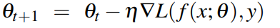
Example of gradient descent
w₁ = w₂ = b = 0;
x₁ = 3; x₂ = 2
Update step for update θ is:
where
Gradient vector has 3 dimensions:
AI/ML Professional Training Program: INNOQUEST COHORT-1
Instructor: Prof. Ahmad Raza Shahid
Notes:
Here's our update equation for SGD. In order to do this update to theta, we'll need to know the gradient of the loss function. In our mini example there are three parameters, so the gradient vector has 3 dimensions, for w1, w2, and b. We can compute the first gradient as follows:

Slide 99
Example of gradient descent
w₁ = w₂ = b = 0;
x₁ = 3; x₂ = 2
Update step for update θ is:
where
Gradient vector has 3 dimensions:
AI/ML Professional Training Program: INNOQUEST COHORT-1
Instructor: Prof. Ahmad Raza Shahid

Slide 100
Example of gradient descent
w₁ = w₂ = b = 0;
x₁ = 3; x₂ = 2
Update step for update θ is:
where
Gradient vector has 3 dimensions:
AI/ML Professional Training Program: INNOQUEST COHORT-1
Instructor: Prof. Ahmad Raza Shahid

Slide 101
Example of gradient descent
w₁ = w₂ = b = 0;
x₁ = 3; x₂ = 2
Update step for update θ is:
where
Gradient vector has 3 dimensions:
AI/ML Professional Training Program: INNOQUEST COHORT-1
Instructor: Prof. Ahmad Raza Shahid

Slide 102
Example of gradient descent
w₁ = w₂ = b = 0;
x₁ = 3; x₂ = 2
Update step for update θ is:
where
Gradient vector has 3 dimensions:
AI/ML Professional Training Program: INNOQUEST COHORT-1
Instructor: Prof. Ahmad Raza Shahid

Slide 103
Example of gradient descent
Now that we have a gradient, we compute the new parameter vector θ¹ by moving θ⁰ in the opposite direction from the gradient:
η = 0.1;
AI/ML Professional Training Program: INNOQUEST COHORT-1
Instructor: Prof. Ahmad Raza Shahid

Slide 104
Example of gradient descent
Now that we have a gradient, we compute the new parameter vector θ¹ by moving θ⁰ in the opposite direction from the gradient:
η = 0.1;
AI/ML Professional Training Program: INNOQUEST COHORT-1
Instructor: Prof. Ahmad Raza Shahid

Slide 105
Example of gradient descent
Now that we have a gradient, we compute the new parameter vector θ¹ by moving θ⁰ in the opposite direction from the gradient:
η = 0.1;
AI/ML Professional Training Program: INNOQUEST COHORT-1
Instructor: Prof. Ahmad Raza Shahid

Slide 106
Example of gradient descent
Now that we have a gradient, we compute the new parameter vector θ¹ by moving θ⁰ in the opposite direction from the gradient:
η = 0.1;
Note that enough negative examples would eventually make w₂ negative
AI/ML Professional Training Program: INNOQUEST COHORT-1
Instructor: Prof. Ahmad Raza Shahid
Notes:
Note that this observation x happened to be a positive example. We would expect that after seeing more negative examples with high counts of negative words, that the weight w2, the weight for the "negative lexicon feature', would shift to have a negative value.

Slide 107
Mini-batch training
Stochastic gradient descent chooses a single random example at a time.
That can result in choppy movements
More common to compute gradient over batches of training instances.
Batch training: entire dataset
Mini-batch training: m examples (512, or 1024)
AI/ML Professional Training Program: INNOQUEST COHORT-1
Instructor: Prof. Ahmad Raza Shahid
Notes:
Stochastic gradient descent is called stochastic because it chooses a single random example at a time, moving the weights so as to improve performance on that single example. That can result in very choppy movements, so it’s common to compute the gradient over batches of training instances rather than a single instance.
For example in batch training we compute the gradient over the entire dataset. By seeing so many examples, batch training offers a superb estimate of which direction to move the weights, at the cost of spending a lot of time processing every single example in the training set to compute this perfect direction.
A compromise is mini-batch training: we train on a group of m examples (perhaps 512, or 1024) that is less than the whole dataset.
Mini-batch training also has the advantage of computational efficiency. The mini-batches can easily be vectorized, choosing the size of the mini-batch based on the computational resources. This allows us to process all the exam- ples in one mini-batch in parallel and then accumulate the loss, something that’s not possible with individual or batch training.

Slide 108
Multinomial logistic regression

Slide 109
Multinomial logistic regression
Often we need more than 2 classes
Text classification: Positive/negative/neutral
Disease detection: covid /pneumonia/ normal
Digit recognition: 0/1/2/3/4/5/6/7/8/9
If >2 classes we use multinomial logistic regression
= Softmax regression
AI/ML Professional Training Program: INNOQUEST COHORT-1
Instructor: Prof. Ahmad Raza Shahid

Slide 110
Multinomial logistic regression
The probability of everything must still sum to 1
P(positive|doc) + P(negative|doc) + P(neutral|doc) = 1
Need a generalization of the sigmoid called the softmax
Takes a vector z = [z1, z2, ..., zk] of k arbitrary values
Outputs a probability distribution
each value in the range [0,1]
all the values summing to 1
AI/ML Professional Training Program: INNOQUEST COHORT-1
Instructor: Prof. Ahmad Raza Shahid

Slide 111
The softmax function
Turns a vector z = [z₁, z₂, ... , z_{k}] of k arbitrary values into probabilities
AI/ML Professional Training Program: INNOQUEST COHORT-1
Instructor: Prof. Ahmad Raza Shahid

Slide 112
The softmax function
Turns a vector z = [z₁,z₂,...,z_{k}] of k arbitrary values into probabilities
AI/ML Professional Training Program: INNOQUEST COHORT-1
Instructor: Prof. Ahmad Raza Shahid

Slide 113
Softmax in multinomial logistic regression
Input is still the dot product between weight vector w and input vector x
But now we’ll need separate weight vectors for each of the K classes.
AI/ML Professional Training Program: INNOQUEST COHORT-1
Instructor: Prof. Ahmad Raza Shahid

Slide 114
Features in binary versus multinomial logistic regression
Binary: positive weight → y=1 neg weight → y=0
Multinominal: separate weights for each class:
w₅ = 3.0
AI/ML Professional Training Program: INNOQUEST COHORT-1
Instructor: Prof. Ahmad Raza Shahid

Slide 115
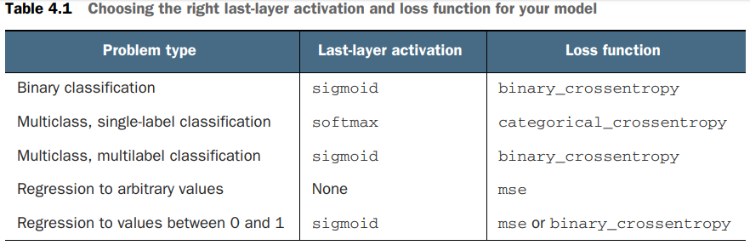
AI/ML Professional Training Program: INNOQUEST COHORT-1
Instructor: Prof. Ahmad Raza Shahid

Slide 116
Choosing a measure of success
For balanced-classification problems, where every class is equally likely, accuracy and area under the receiver operating characteristic curve (ROC AUC) are common metrics.
For class-imbalanced problems, you can use precision and recall.
For ranking problems or multilabel classification, you can use mean average precision.
And it isn’t uncommon to have to define your own custom metric by which to measure success
AI/ML Professional Training Program: INNOQUEST COHORT-1
Instructor: Prof. Ahmad Raza Shahid

Slide 117
Reference
Machine Learning with PyTorch and Scikit-Learn (Sebastian Raschka, Yuxi Liu, Vahid Mirjalili)
Machine Learning (Tom M. Mitchell)
Pattern Recognition and Machine Learning (Christopher M. Bishop)
Stanford lectures (dan jurafsky)
AI/ML Professional Training Program: INNOQUEST COHORT-1
Instructor: Prof. Ahmad Raza Shahid

Slide 118
Thank you

